Slide 1



Dynamic Websites
Topic 10:
Web services
Notes:
NCC Education - Title Master

Slide 2
Content
SOAP
REST
RSS
Web API
Notes:
NCC Education - Slide Master

Slide 3
Introduction
In this lecture, we are going to look at the topic of web services.
Specifically, how we can consume the services that others have written.
We are ready to create simple web services.
A PHP script that interprets a GET request makes an effective “first draft” of a web service.
There are many pre-written services on the Internet that we can profitably integrate into our own code.

Slide 4
Web API
Web services are based on SOAP protocol.
Web API is framework used to help build REST interfaces.
Web SOAP based service returns data as XML.
Web API is a HTTP based service which returns JSON or XML data.

Slide 5
REST and SOAP
Most web services are based on one or two systems.
Simple Object Access Protocol (SOAP)
Representational State Transfer (REST)
The former is a more mature system for implementing web service.
Heavily standards based
The latter is more modern and lightweight.
Simple communication via XML

Slide 6
SOAP
SOAP is an XML based protocol.
However, the structure of the documents that are sent via SOAP are very strictly controlled.
The root element of the XML document is called the envelope.
Inside this envelope are the header and the body.
We construct an envelope that contains the information we want.
We get back an envelope that contains the response.

Slide 7
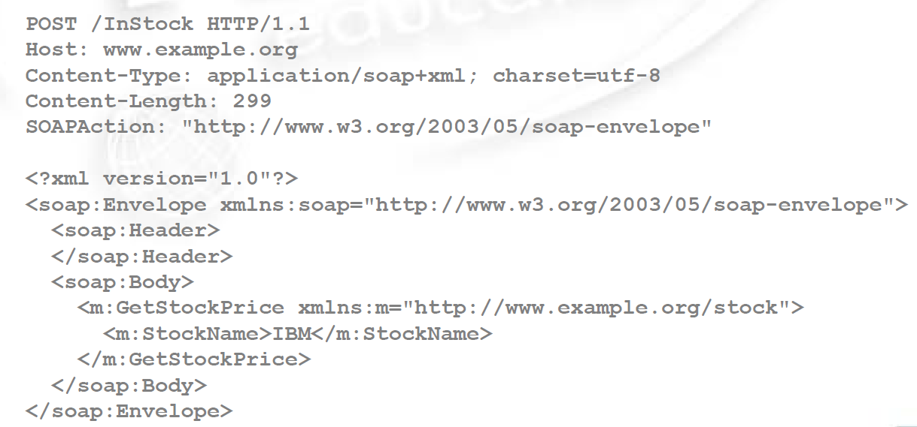
Example SOAP Envelop

Slide 8
Using SOAP
Most SOAP implementation engines will let you ignore the details of constructing the building SOAP envelopes.
SOAP documents will often be more complex than simple example.
They can include other things, such as error handling.
SOAP envelopes can be sent using a number of protocols.
SMTP and HTTP being two valid examples.

Slide 9
REST
REST is a more lightweight protocol associated with the Web 2.0 movement.
This focus is on using HTTP to transport simple XML documents.
REST is a style of interaction summed up as four actions:
GET, POST, PUT, DELETE
Each of these verbs map onto particular states.
You use these operations to do different things.

Slide 10
GET & PUT
We have already seen GET and PUT
But we didn’t talk about what they were supposed to be used for.
GET is meant as a mechanism for querying data, provided that query has no side-effects.
PUT is meant to permit you to add or modify existing data.
They serve as opposites of each other.

Slide 11
POST & DELETE
DELETE is self explanatory.
It deletes something on the server.
POST, which we have used before, is a little different.
It allows anything to happen.
It provides “a black of data” as a response to a “data handling request”
The distinction between PUT and POST is a subject of much debate!

Slide 12
REST Web Services
A REST web service is one in which three elemtns are defined.
The location of the service (a URL)
The type of data supported by the service (we use XML, but other protocols are possible)
The set of operations that are supported.
When we access a REST web service, the type of action we perform will influence the outcome.
There are no set standards for REST web services.

Slide 13
SOAP versus REST - 1
These are complementary systems.
They both have their strengths and weaknesses.
REST has a much lower overhead.
Much less data to be transported.
Makes use of existing HTTP protocols.
SOAP is standardised.
There is a set of protocol in a way that does not exist for REST services.
SOAP makes no assumptions of the transport layer.

Slide 14
SOAP versus REST - 2
REST requires the implementation of an HTTP stack on both systems.
This can make it problematic for some specialist devices.
SOAP allows for the incorporation of further document standards, such as WS Security.
For day-to-day purposes, REST is a more flexible and popular system.
For enterprise use, SOAP has the edge.

Slide 15
WSDL
The details of a web service are encoded in an XML document following the format defined as the Web Services Description Language (WDSL).
Only WSDL 2.0 supports the REST architecture.
This defines all of the information we require to make use of a service.
URIs, parameters, and how to interpret output.
It can be quite difficult to read, and so we usually rely on web-tools that provide the data in a more comprehensible form.

Slide 16
Consuming Web Services
Let us look at an example of consuming a web-service defined in SOAP.
We will use the web service defined at:
http://www.webservicex.net/WS/WSDetails.aspx?WSID=9&CATID=2 for this.
This web service permits us to provide the symbol for a corporation and receive stock information back.
We will use this as the basis for a stock query system.

Slide 17
Consuming a SOAP Service - 1
To consume the SOAP service, we need to know the location of its WSDL.
This tells us what methods it exposes, what parameters it provides, and what the response will be.
We will use SoapClient object to create the connection to the webservice.
We call methods on the service using -> notation.
Parameters must be provided as an associative array.

Slide 18
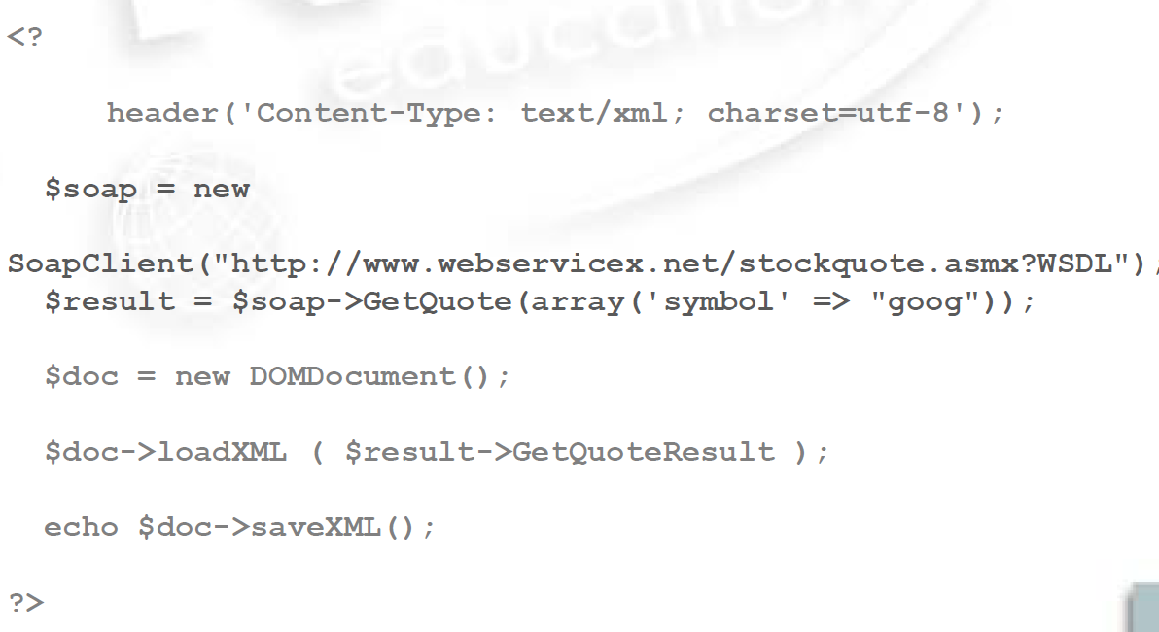
Consuming a SOAP Service - 2

Slide 19
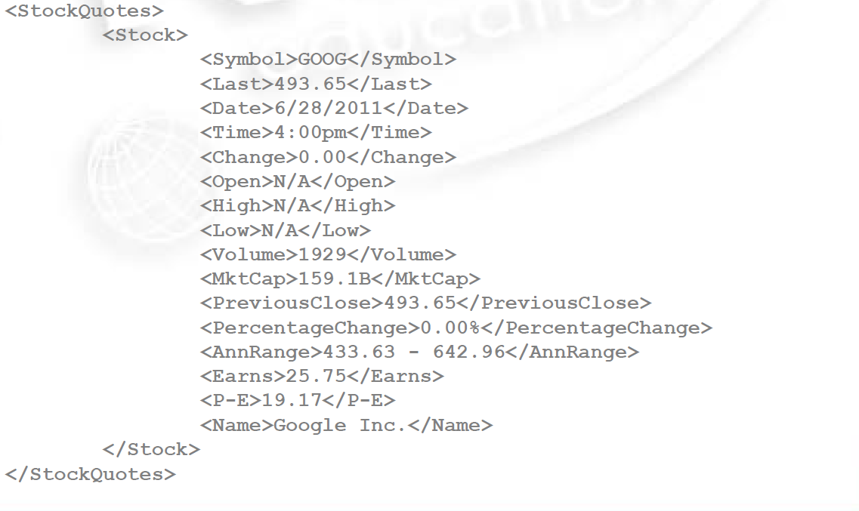
Response for GOOG

Slide 20
The Ajax Frontend - 1
This PHP script creates the connection to the web service and parses it out as an XML document.
We can then navigate this in the ways we have already explored during the module.
The nature of the XML document we get is not defined in the WSDL file.
We need to manually appraise it before working out how to display it.
Luckily, it does not matter at all to DOM.

Slide 21
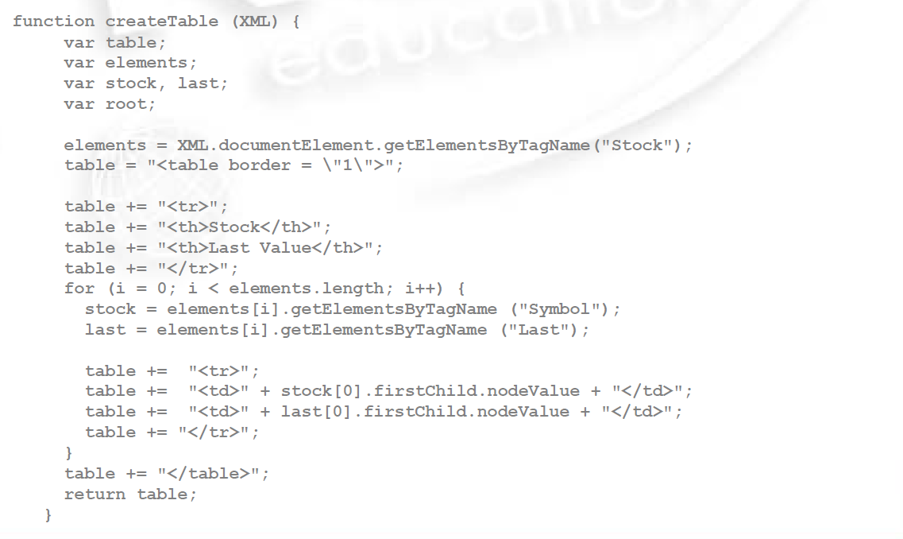
The Ajax Frontend - 2

Slide 22
Consuming a REST Service
Consuming a REST service follows the same general structure.
Create the appropriate object
Configure it
Return an XML tree of the results.
However, PHP has no built-in objects for handling REST communications.
This is one of the downsides of a lightweight architecture.
We have to do it manually.

Slide 23
CURL
PHP comes equipped with a range of functions designed to simplify communication with remote resources.
It is called CURL.
We use CURL to negotiate our REST requests.
We can use it for many other things also.
To Setup a CURL request, we need to pass a URL to the curl_init function.
Let us use a different web service for this.

Slide 24
Google Directions
The REST service we are going to consume for our example if the Google Directions web service.
http://code.google.com/apis/maps/documentation/directions/
This needs us to provide three pieces of information:
The starting point
The destination
Whether our information comes from a device with a location sensor.

Slide 25
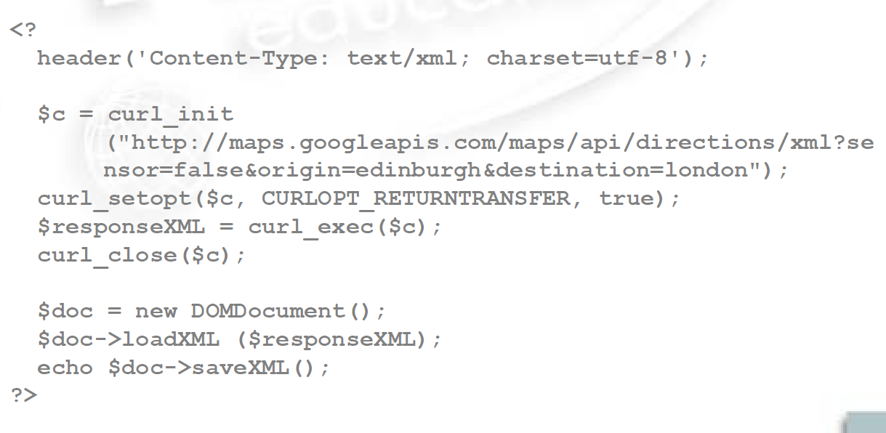
Consuming a REST Service

Slide 26
Google Directions
The document that we get from this is quite complex.
And full of things we do not need.
However, it has the following nodes:
html_instructions
Distance
Value/Text
Duration
Value/Text
We already know how to parse this.

Slide 27
Mash-Ups - 1
Many of the most vibrant new websites are mash-ups.
Taking the processing of one service and integrating it with another.
We can perform a simple mash-up here.
What if we knew where the user was located, and automatically gave them directions to a location?
There is a web-service that tells us where an IP address is located:
https://www.easycounter.com/report/freegeoip.appspot.com

Slide 28
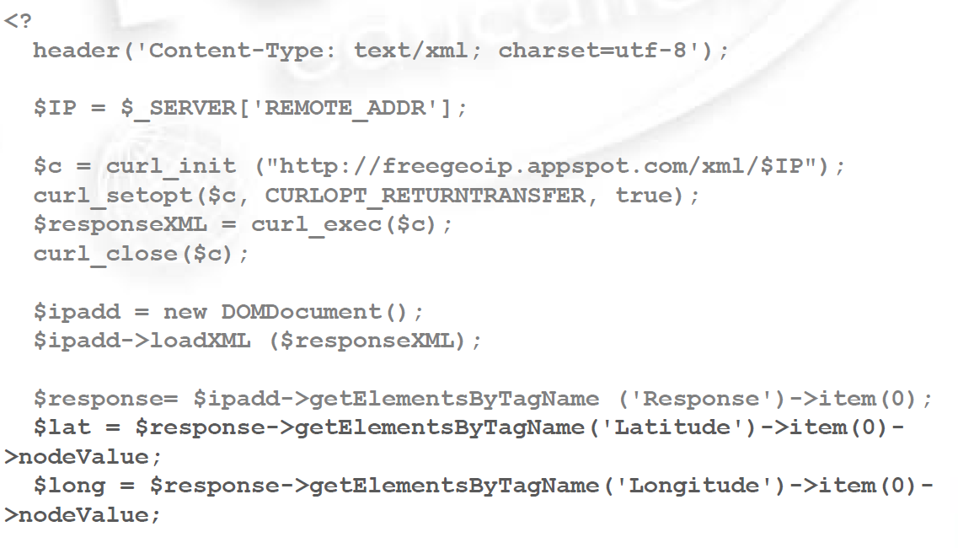
Mash-Up PHP - 1
$c = curl_init (“https://www.easycounter.com/report/freegeoip.appspot.com”);
Curl_setopt($c, CURLOPT_RETURNTRANSFER, true);
$responseXML = curl_exec($c) ;
Curl_close($c);

Slide 29
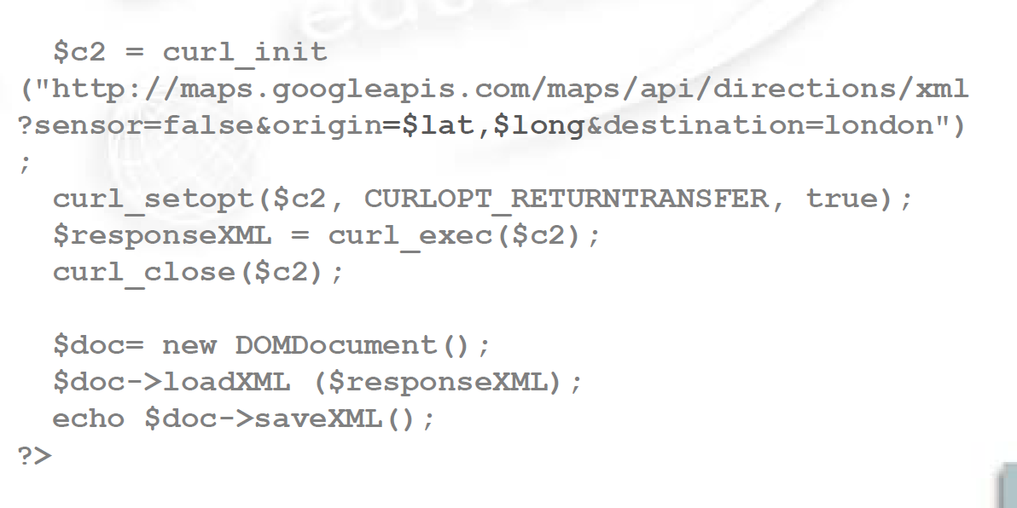
Mash-Up PHP - 2

Slide 30
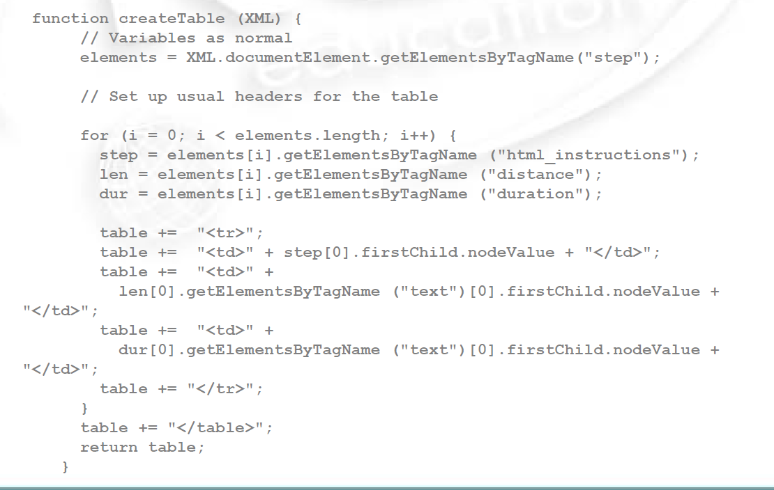
Ajax Frontend Table

Slide 31
Mash-Ups 2
The power of web-services is based on the easy deployment and consumption of distributed functionality.
That in itself is based on the relative ubiquity of XML as a data format.
Every web service gives us a data structure that we know how to parse.
All we need to know is what the elements are and what they mean.

Slide 32
Mash-Ups - 3
Modern web applications are becoming tremendously powerful.
And often leverage vast data sets out of the feasible grasp of independent developers.
Sometimes gaining access to these applications is costly.
Sometimes you just need to register as a developer.
Sometimes you need to pay a fee.
There is much value though to be had in innovative integration of these services.

Slide 33
Mash-Ups - 4
Sometimes we only use a web-service to gain access to otherwise difficult functionality.
Validating credit cards
Address lookups
It is risky to build an application around an external web service.
They are not always available.
The terms and conditions are not always stable.
Sometimes though, you have no real choice.

Slide 34
Web Services - 1
The web is full of services, both free and commercial.
http://www.programmableweb.com/ is a useful website that permits you to query what is out there.
Most “big name” internet companies will have API that will allow you to leverage their power.
Many sites for example permit you to login via a facebook/twitter user account rather than through a bespoke login system.
You need to weigh up the pros and cons ….

Slide 35
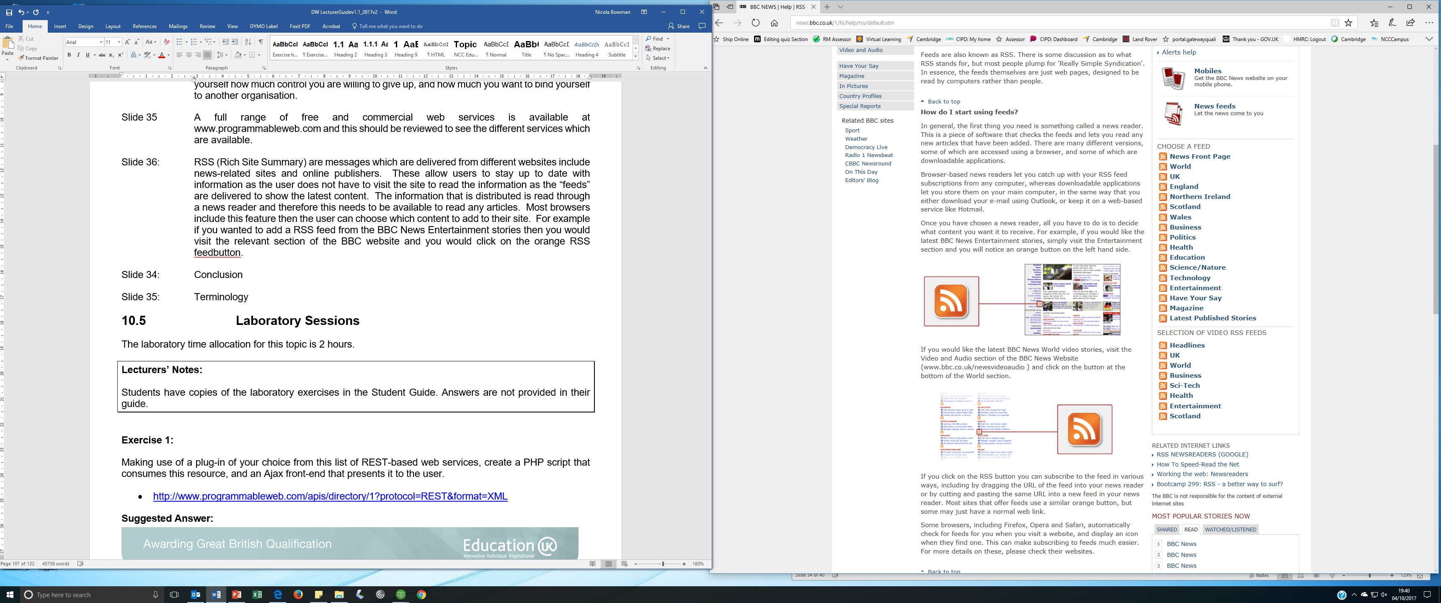
RSS
RSS feeds are useful as they display up to date content which is delivered regularly to the subscriber.
RSS feedback can be added to a website. The orange icon below identifies RSS feedback. This is linked to the BBC website and can be added to any website.

Slide 36
Conclusion
Web services come in two main flavours – SOAP and REST.
SOAP is a well-defined, enterprise level protocol for web services.
REST is a more lightweight, ad hoc architecture.
Consuming web services makes “free” complex functionality available to your web applications.
But you need to be mindful of the potential consequences of utilising them.

Slide 37
Terminology
SOAP - A well defined protocol for remove web application access
REST - A lightweight architecture for accessing remote web functionality
Web service - A remote web application that that permits for external applications to make use of its functionality
Mash-up - A web application that integrates data from multiple web services.

Slide 38
References
BBC, 2017. [online] Available at www.bbc.co.uk
Googlemaps, 2017. [online] Available at : http://code.google.com/apis/maps/documentation/directions/
Freegeoip.appspot.com, 2017. [online] Available at:http://freegeoip.appspot.com/
Programmableweb.com, 2017. [online] Available at: http://www.programmableweb.com

Slide 39
Topic 8 – Web Services
Any Questions?
Notes:
NCC Education - End Slide Master

